Slide 1




1st National Conference On
VLSI, SIGNAL PROCESSING, IOT & COMMUNICATION
ENGINEERING (VSPICE-2026)
Buddha Institute of Technology
GIDA, Gorakhpur
HybridX car
Aashish Yadav
Electronics & Communication Engineering| 3rd Year
Guided by : Mr. Akhilesh Mishra

Slide 2
Contents
Introduction
Problem Statement
Objectives
Literature Survey
Proposed Solution / Methodology
Results & Analysis
Conclusion & Future Work
Acknowledgements
References

Slide 3
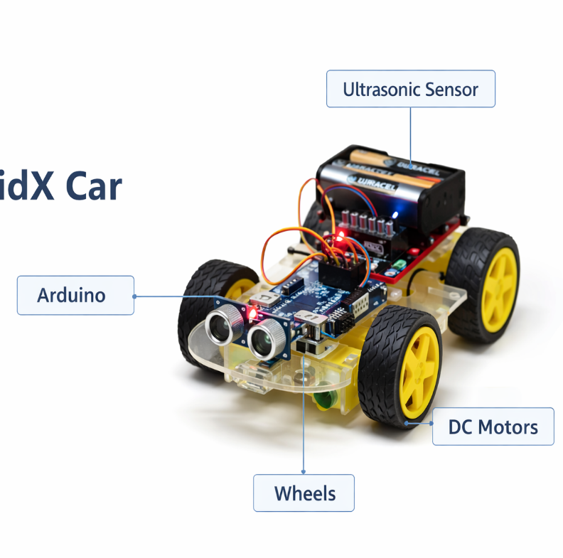
Introduction
Arduino-based smart robotic vehicle
Works in Remote, Voice & Automatic modes
Ultrasonic sensor for obstacle detection
Provides safety and intelligent movement
Combines manual and autonomous control
Smart and flexible robotic transportation system
.

Slide 4
Problem Statement
Measurable economic loss & erosion of civic trust.
Triggers | Results
Single control mode | Higher risk of collisions
Limited obstacle detection | Inefficient navigation
No remote, voice & auto integration | Lack of intelligent decisions
Reduced manual flexibility | Need for safe multi-mode robotic system

Slide 5
Objectives
To design a multi-mode robotic vehicle system
To integrate remote, voice, and autonomous control
To implement obstacle detection for enhanced safety
To enable smooth switching between control modes
To improve navigation efficiency in dynamic environments
obstacle

Slide 6
Literature Survey
Existing Research | Source | Limitation | Our Approach
Arduino-based obstacle avoiding robot | Research papers & basic prototypes | Only automatic mode | Multi-mode control added
Voice controlled robotic vehicle | Bluetooth/voice command systems | No obstacle detection | Voice + safety integration
Remote controlled robot | RF/Bluetooth remote systems | Fully manual, less safety | Remote with intelligent control
Ultrasonic sensor navigation robot | Sensor-based navigation projects | Single-mode operation | Integrated multi-mode system
Autonomous obstacle avoidance robot | Basic AI/automation projects | No manual flexibility | Manual + autonomous combined

Slide 7
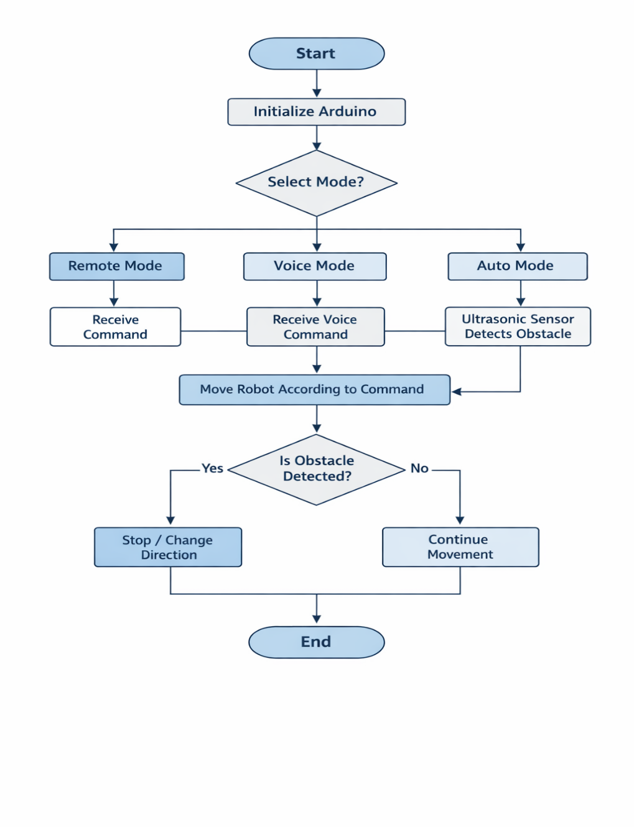
Proposed Solution / Methodology
Arduino-based intelligent control system
Multi-mode operation: Remote, Voice & Automatic
Real-time obstacle detection using ultrasonic sensor
Automatic stop and smart direction control
Integrated manual and autonomous navigation
Enhanced safety and flexible performance
Fix It Now Platform
Smart AI Processing

Slide 8
Expected Results & Analysis
MODE | STATUS | OBSERVATION
Remote mode | Successful | Smooth wireless control
Voice mode | Successful | Accurate command response
Auto mode | Successful | Detected obstacles correctly

Slide 9
Conclusion & Future Work
Conclusion | Future Work
Multi-mode robotic vehicle successfully designed | Add camera for vision-based navigation
Remote, Voice & Automatic control implemented | Integrate AI for smart decision making
Ultrasonic-based obstacle detection improves safety | Use IoT for mobile app monitoring
Flexible manual and autonomous operation achieved | Add GPS for outdoor navigation
System is low-cost and efficient | Upgrade to advanced sensors for accuracy
Advanced Integration

Slide 10
Acknowledgements
I would like to express our sincere gratitude to:
Mr. Akhilesh Mishra (Assistant Professor, ECE)
for his valuable guidance, continuous support, and encouragement throughout this project.
Department of Electronics and Communication Engineering
for providing the necessary resources, learning environment, and technical support.
Buddha Institute of Technology, GIDA, Gorakhpur
for giving us the opportunity to work on this project and present it at this National Conference.
Our Project Team Members
for their teamwork, dedication, and collaborative efforts in successfully completing this work.

Slide 11
References
1. Arduino Official Website, “Arduino Uno Rev3,” Available: https://www.arduino.cc
2. J. Borenstein and Y. Koren, “Obstacle Avoidance with Ultrasonic Sensors,” IEEE Journal of 3. Robotics and Automation, 1988.
4. HC-SR04 Ultrasonic Sensor Datasheet, Distance Measuring Module Specifications.
5. Bluetooth Module HC-05 Datasheet, Wireless Serial Communication Module.
6. S. Thrun, W. Burgard, and D. Fox, Probabilistic Robotics, MIT Press, 2005.

Slide 12
THANK YOU

